Slide 1
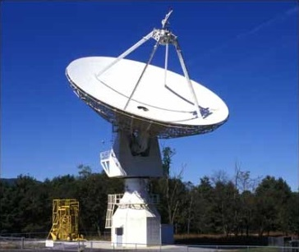

SARA Conference 2023
Inter-Stellar Medium (ISM): Dispersion Measure

Slide 2
Agenda
20 Meter Dish Demo
Pulsar Observing (short refresher)
Dispersion Measure (DM) Observing
ATNF
(DM) Observing - Crab Pulsar
(DM) Observing - Other
SARA Analytical Section Open Forum

Slide 3
20 Meter Dish Demo
This 20m Demo and SARA Section Update are posted on SARA Analytical Section page
Also Posted:
  2019 demo presentation posted (Cas A Flux Density Calculation)
  2020 demo presentation posted (Pulsars)
  2021 demo presentation posted (Masers)
  2022 demo presentation posted (Raster Scans)
Green Bank Conference Account - Explore!
Demo Example – Watch the dish move outside!
See Green Bank and McGill University scientist Ryan S. Lynch’s “Searching for and Identifying Pulsars” guide posted on the internet.
http://www.gb.nrao.edu/20m/psr20m_advice.html
https://www.physics.mcgill.ca/~rlynch/Outreach/PSC_search_guide.pdf
https://astronomy.swin.edu.au/cosmos/p/pulsar+dispersion+measure

Slide 4
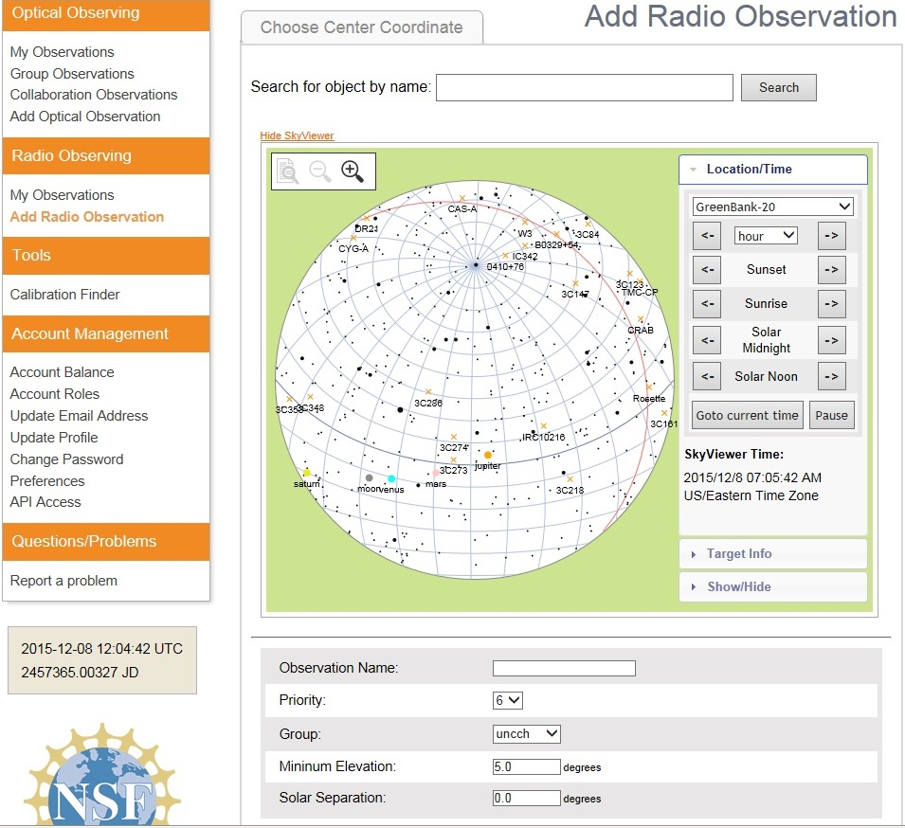
20 Meter Dish Demo
Add a Radio Observation
-Select an Object
(Database or RA/Dec)
-Minimum Elevation
(Used for mapping)
-Solar Separation
(to prevent solar side lobe
interference)

Slide 5
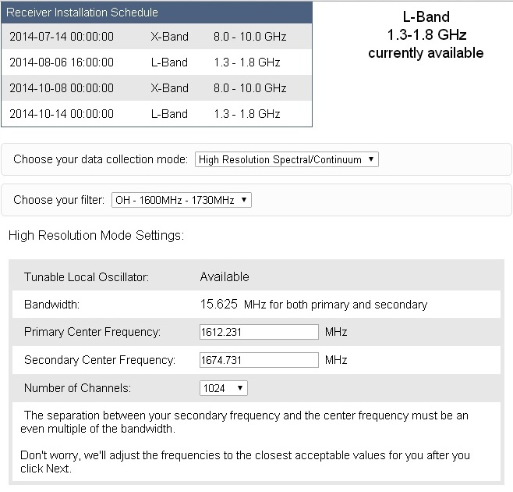
20 Meter Dish Demo
Configure Receiver
Low Resolution: continuum mapping/pulsars
High Resolution: Spectral Lines
No Filter Full Band (with interference)
H1 Filter (continuum maps, 1355-1455 MHz)
OH Filter (Iridium sat. interference, 1.6-1.73 GHz)
Data Collected in Bins: Time bins (data collected in a small chunk of time) or frequency bins (data collected in a small chunk of observing frequency).

Slide 6
Pulsar Observing
Observing pulsars allows the Inter-Stellar Medium to be studied. Every pulsar has a name that defines its position in the sky (in J2000 coordinates). For example, PSR J0437-4715 is a pulsar with right ascension 04:37 and declination -47:15. For epoch 1950-1999, astronomers used B1950 coordinates. Letters are used to distinguish pulsars that are close together. For instance, PSRs J0024-7204C and J0024-7204D are two different pulsars in the globular cluster 47 Tucanae.
For comparison, the coordinates of a typical star may look something like: 12:52:03.32, -47:34:43.0, J2000.0: In the year 2000, the star had an RA of 12 hours 52 minutes and 3.32 seconds, and a Dec of 47 degrees 34 arcminutes 43 arcseconds south of the celestial equator.
RA starts on the Greenwich meridian. RA meridians fall on the celestial sphere. RA is measured eastward with values ranging from 0 to 24 hours. RA can be converted into decimal form and degrees, and vice versa.

Slide 7
Pulsar Observing
20m Notes for Your DM Observation
Choose a recognizable pulsar name, for example, "B0329+54“, and correct pulsar RA/DEC coordinates.
Select "Low Resolution Spectral/Continuum (HI Filter)" and check the "Pulsar Mode" box.
Select "Track.“ Bright pulsars can be detected with a duration of 60s. Up to 1800s for weaker pulsars.
Set the integration time: Use 1/100 of the pulsar period for a good profile. Integration time range: 0.1 to 0.0001.
The term integration time is used for radio telescopes for the length of time over which data is collected and combined. It generally means the time over which an analog signal is converted into a digital count representing an integration of the signal. Such an integration time may be chosen as best to reduce the relative effects of systematic noise and/or random noise. Generally, lengthening the integration time improves the signal-to-noise ratio (SNR). For transients, there is a trade-off between the integration time length needed to achieve a usable SNR versus the time-resolution needed to sense the ongoing changes of interest.
http://www.gb.nrao.edu/20m/psr20m_advice.html

Slide 8
Pulsar Observing
PRESTO Prepfold Plots: These are the results of a pulsar observed through the 20m radio telescope.
This is one of the many diﬀerent packages of software designed for observing pulsars. PRESTO takes the Fourier transform of a data set and uses algorithms to search for pulsars. When PRESTO ﬁnds a promising candidate, it can go back to the time domain data and use a program called prepfold to fold the data at the period of a candidate. What comes out is a plot like the following figure.

Slide 9
Pulsar Observing
Dispersion Measure Panel
The peak of the curve shows the most likely value of DM. Ideally, we would like to see a sharp peak at one value of DM. This would mean that the DM is well measured. If the peak is broader, it means that the DM measurement is less certain.
If the curve reaches its highest point at a DM of zero, then the signal must not have traveled through any electrons to get to Earth. That must mean that the signal actually originated at the Earth, and is actually RFI. The DM of a signal is one of the best ways we have of distinguishing between RFI and a true astronomical signal from space.
This panel shows the Dispersion Measure, or DM. The DM is a way of quantifying the number of electrons that the pulsar’s signal must travel through to reach the Earth. The y-axis is the Reduced χ2. A real pulsar should have a peak value of Reduced χ2 at a non-zero DM.

Slide 10
Pulsar Observing
Dispersion Measure Panel
In this figure, the x-axis is labeled as “DM”, and the y-axis as “Reduced χ2”. The DM tells us something about the space between Earth and the pulsar. Space is ﬁlled with many things. One of the things are electrons. These electrons disperse the pulsar’s signal, causing lower observing frequencies to arrive later than higher observing frequencies. The electrons can also scatter the signal in much the same way smoke scatters visible light.
The symbol “χ” is the Greek letter “X”. The Reduced χ2 is a statistical value that indicates how well a model agrees with some actual data. A large value of Reduced χ2 means that the model and data are not in good agreement, and a Reduced χ2 of one means that they are.
Helpful links:
Pulsar http://pulsarsearchcollaboratory.com/week-2-dispersion-measure/
DM Lecture 1 (direct video link: https://vimeo.com/241939467)
DM Lecture 2 (Direct video link: https://vimeo.com/241579444)

Slide 11
Pulsar Observing
Column Density
DM manifests itself observationally as a broadening of an otherwise sharp pulse when a pulsar is observed over a finite bandwidth. The DM is the integrated column density of free electrons between an observer and a pulsar. The DM represents the number of free electrons between the observer and the pulsar per unit area. The binary pulsar PSR J0437-4715 has had its parallax distance determined from pulsar timing to be 156 pc. The dispersion of 2.643 pc cm⁻³ means that the mean electron density between the Earth and the pulsar is:
n_{e} = DM/D = 2.643/156 = 0.017 electrons/cm³
Radio waves interact with the electrons in the ISM causing the waves to travel slower. At lower frequencies waves travel slower and the pulses arrive later. By comparing the arrival times of the same pulse at two radio frequencies one can measure the electron-density of the ISM.
Some pulsars can have a low DM. Moreover, some sources of RFI can appear to have a non-zero DM. Seeing a signal that has a non-zero DM does not necessarily mean that the signal is from a real pulsar. DM units are “parsecs per centimeter cubed.” A parsec is about 3.3 light years. Since we are dividing a distance by another unit of distance cubed, what we have is a number per distance squared. Astronomers commonly refer to this as “column density”. This is the number density of electrons integrated along the path from the telescope to the pulsar.
https://astronomy.swin.edu.au/cosmos/p/pulsar+dispersion+measure
http://www.ncra.tifr.res.in/rpl/pos/experiments/estimation-of-the-distance-to-the-pulsar-by-measuring-the-dispersion-delay-of-the-pulse.pdf

Slide 12
DM Observing
The gas and dust that fills the space between stars is called the interstellar medium (ISM). One can visually observe the ISM as nebulae of glowing gas or dark regions that are obscuring stars behind them. The ISM of the Milky Way is comprised of the following:
Molecular Clouds: 10²–10⁶ particles/cm³
Cold neutral medium (CNM): 20–50 particles/cm³
Warm neutral medium (WNM): 0.2–0.5 particles/cm³
Warm ionized medium (WIM): 0.2–0.5 particles/cm³
H II regions: 10²–10⁴ particles/cm³
Coronal gas Hot ionized medium (HIM): 10⁻⁴–10⁻² particles/cm³
Stars form from the ISM and replenish it with heavier elements when they die. One way the properties of the ISM can be studied is by looking at the radio waves produced by a pulsar. Pulsars rotate and have a beam of radio emission. These beams are thought to be related to the strong magnetic field of the pulsar and are emitted from the poles. As the beams cross the line of sight a pulse is seen. These pulses have very stable shapes with predictable times of arrival. The pulses travel through, and are disturbed by, the ISM between the pulsar and the Earth. Since these objects are moving relative to each other, the pulse signal passes through different interstellar material at different times. Monitoring the changes in the pulsar signal allows us to investigate the properties of the ISM through which it has passed. Interstellar dispersion is related to the ISM’s refractive index causing a dispersion of radio waves. Light passing through a prism is a similar process.

Slide 13
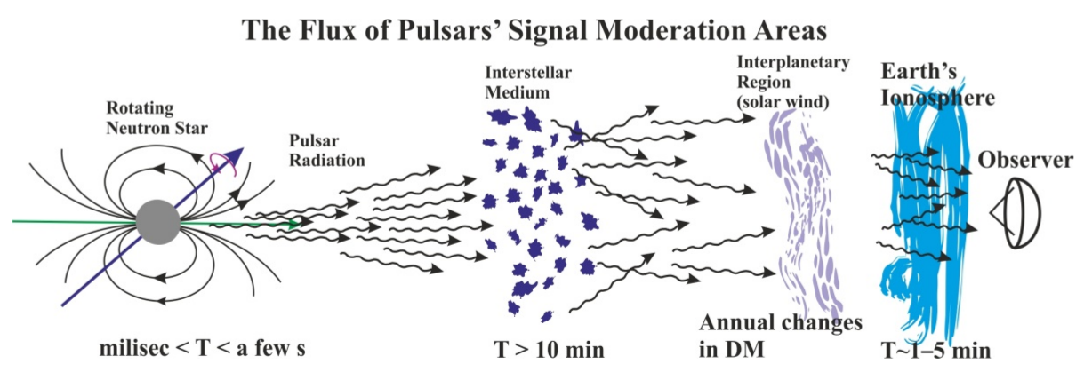
DM Observing
Not Shown: Variations due to discrete structures within the pulsar nebula. The nebula contains density ripples: wisps, clouds, and irregular regions of turbulence. Observed changes in pulse shape are due to the influence of the nebula, since the electron number density variations within the nebula are several orders of magnitude higher than those in the ISM.
Ref: Finding the Ionospheric Fluctuations Reflection in the Pulsar Signals’ Characteristics Observed with LOFAR
Leszek P. Błaszkiewicz, et al
Sensors 2021, 21(1), 51. https://www.mdpi.com/1424-8220/21/1/51/htm

Slide 14
DM Observing
Related Terminology to Interstellar Dispersion
Interstellar scintillation: The variable-density ISM disrupts the phase of the pulsed radio signal. Constructive and destructive interference of the wave front results in an interference pattern through which the Earth moves. This is seen as a variation in time of the intensity (flux) of the signal.
Interstellar scattering: This effect causes the shape of a pulse signal to broaden as it is scattered through the medium. The random density of ISM causes the signals to travel many different paths as they are refracted. When a signal takes a bent path, it travels a longer distance to the telescope and thus the signal will arrive later. This scattering contributes to extinction, is the dimming of distant objects due to the presence of dust in the ISM along the line of sight. Interstellar extinction curves are available for many lines of sight in the Milky Way Galaxy.
Faraday Rotation: is an effect in the propagation of radio waves through the ISM, pulsar magnetospheres, and through the Earth’s ionosphere. Radio emissions from pulsars are generally highly polarized. When the radio waves propagate through the magneto-ionized ISM, the linear polarization plane is rotated. This YouTube explains this phenomenon very well: https://youtu.be/XhU-nNiAgtI.
Smearing: When radio waves from pulsars pass through the electrons in the ISM, they are delayed. All the frequencies of pulsar’s emission leave the pulsar itself at the same time, but they arrive on Earth at different times: the lower a wave’s frequency, the more its arrival on Earth is delayed. Because of this effect, the pulses we receive are “smeared” over a period of time instead of being straight lines. This smearing makes it more difficult to detect the pulses. But, if we know how smeared a pulse is, we can correct it and detect the pulse. Dispersion measure tells us how much correction we need to do to line the pulses back up. The higher the DM, the more the pulse was smeared. The more the pulse was smeared, the greater the signal path through the free electrons.

Slide 15
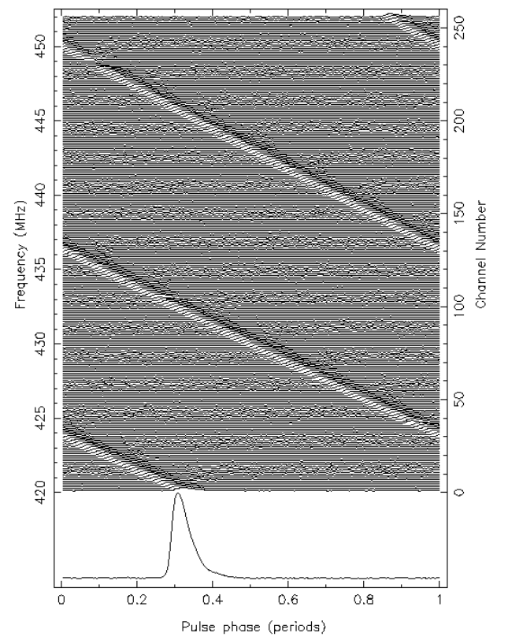
DM Observing
Dispersion Measure Properties
As radio waves travel through the ISM, they encounter ionized gas with a refractive index different to that of empty space. In the presence of charged particles such as electrons, the electrostatic interaction between the radio waves and the charged particles causes a delay in the propagation of the radio waves. More energetic photons tend to push past the free electrons with little effect on their speed, whereas lower frequency photons are more significantly delayed. Electrons react to the passing radio waves more than protons due to their much lower masses and this causes greater delays in the radio wave propagation time. This ionized gas has the effect of putting a delay in the arrival time of the radio pulse, depending on the frequency of the radiation. The higher frequencies end up traveling faster through the interstellar medium, with pulses in the highest frequency arriving first. Each lower frequency channel exhibits a pulse that arrives slightly after the one before it, all the way down to the lowest frequency. The pulse strength (flux), shape (scattering timescale) and arrival times tell us about the scintillation, scattering, and the electron-density properties of the ISM.
https://www.atnf.csiro.au/outreach/education/pulseatparkes/pulsar_properties.html

Slide 16
DM Observing
Dispersion Measure Properties
Turbulent space and astrophysical plasmas are present in a wide range of astrophysical media, from the Earth's magnetosphere to distant star-forming clouds.
The mechanisms governing fluid turbulence are still not fully understood. The favored way of studying turbulence is to resort to a statistical approach. Kolmogorov was among the pioneers in this field with his four-fifths law (Kolmogorov 1941), an exact relation for homogeneous incompressible isotropic hydrodynamic (HD) turbulence.
The magnitude of pulsar variations can be above what models would predict for an ISM dominated by Kolmogorov turbulence. This excess as likely due to a pulsar's local environment (the supernova remnant) and a pulsar’s wind nebula. Analysis of Crab Nebula pulsar observations have revealed a frequency dependence of the pulse smearing time. The DM of the Crab pulsar has been observed to increase by 0.02 cm−3 pc yr−1 between 1982 and 1988, attributed to variations within the turbulent environment of the local Crab SNR.
In most cases, a pulsar's DM is constant, but several long-term studies of DM have revealed temporal variations on time-scales of months to years. Variations in dispersion have been used to study turbulent structure in the free electron density of the ISM.

Slide 17
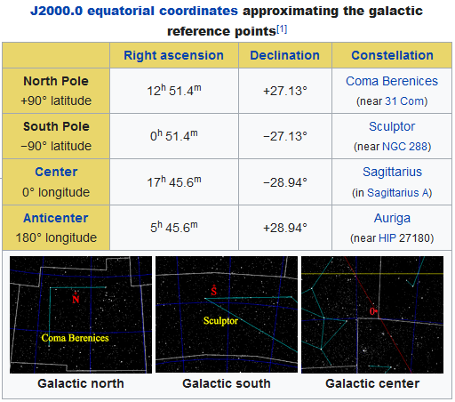
DM Observing
Dispersion Measure Properties
If the pulsar is in the plane of the galactic disk, there is a lot of ISM. The DM can be very high. If the pulsar is outside the plane of the galaxy, the amount of ISM is less, and the DM is lower.
A cold plasma of free electrons affects radio propagation and hence the observed pulse shape of a pulsar in two dominant ways: through dispersion and through multipath scattering. The delay experienced by scattered rays causes the observed pulse profile of a pulsar to be broadened, and to exhibit a characteristic exponential scattering tail.
Dispersion causes the group velocity of the signal to be frequency dependent. If left uncorrected, the delay causes the received signal to sweep across the observing bandwidth, resulting in a broadening of the observed profile. The emission from pulsars experience a time delay as it passes through the ISM due to the dispersive effects of its plasma component. The group delay of this signal depends on the observation frequency and the electron density along the line of sight.
Reference: https://en.wikipedia.org/wiki/Galactic_coordinate_system

Slide 18

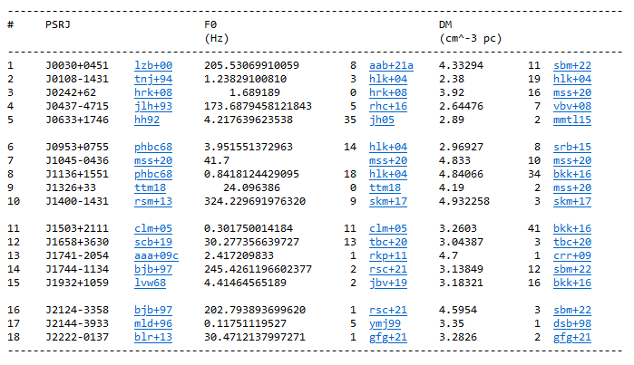
DM Observing
Then Press Table
Australia Telescope National Facility (ATNF) website, ATNF Pulsar Catalogue
https://www.atnf.csiro.au/research/pulsar/psrcat/
Paper: Manchester, R. N., Hobbs, G.B., Teoh, A. & Hobbs, M., AJ, 129, 1993-2006 (2005)

Slide 19

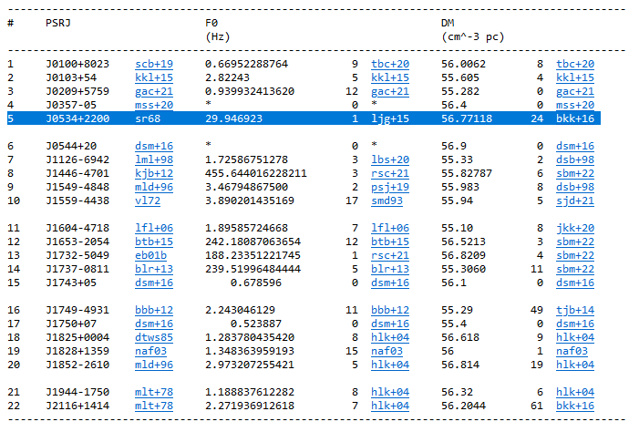
DM Observing
Then Press Table
The Crab Pulsar (PSR B0531+21, also known by the J2000 name PSR J0534+2200) was discovered in 1968. It is the remnant of its progenitor supernova SN 1054.
ATNF Pulsar Catalogue
https://www.atnf.csiro.au/research/pulsar/psrcat/
Paper: Manchester, R. N., Hobbs, G.B., Teoh, A. & Hobbs, M., AJ, 129, 1993-2006 (2005)

Slide 20

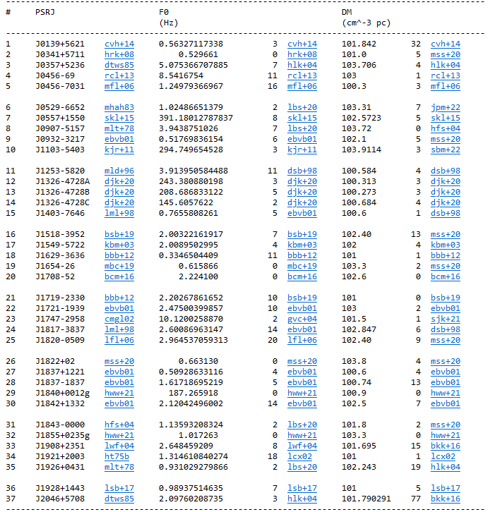
DM Observing
Then Press Table
ATNF Pulsar Catalogue
https://www.atnf.csiro.au/research/pulsar/psrcat/
Paper: Manchester, R. N., Hobbs, G.B., Teoh, A. & Hobbs, M., AJ, 129, 1993-2006 (2005)

Slide 21
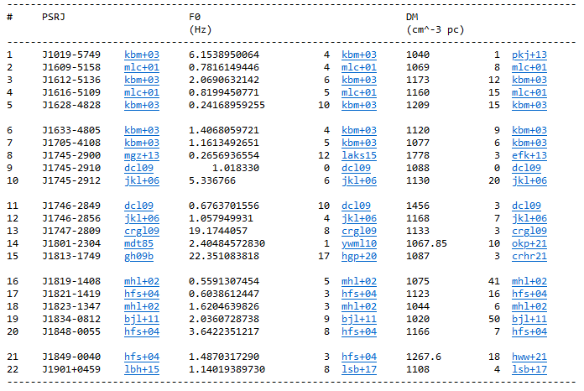
DM Observing
DMs over 1000
DM can be thought of as a measurement of distance. The higher the DM, the farther the pulse traveled.
ATNF Pulsar Catalogue
https://www.atnf.csiro.au/research/pulsar/psrcat/
Paper: Manchester, R. N., Hobbs, G.B., Teoh, A. & Hobbs, M., AJ, 129, 1993-2006 (2005)

Slide 22


ATNF
ATNF Pulsar Catalogue v1.68: Documentation
G. Hobbs, R. N. Manchester and L. Toomey
CSIRO Astronomy and Space Science, Australia Telescope National Facility, PO Box 76, Epping, NSW 1710, Australia
The ATNF Pulsar Catalogue
Includes all published rotation-powered pulsars, including those detected only at high energies, and Anomalous X-ray Pulsars (AXPs) and Soft Gamma-ray Repeaters (SGRs) for which coherent pulsations have been detected. However, it excludes accretion-powered pulsars such as Her X-1 and the X-ray millisecond pulsars. To access, use the web interface ( http://www.atnf.csiro.au/research/pulsar/psrcat ). Appendix A: The Pulsar Parameters, lists the commonly used pulsar parameters.
A Few More Examples
To produce a list of the names and Galactic coordinates of all the known pulsars with periods greater than two seconds and distances greater than 3 kpc:
Click on the box to the left of 'Name', 'GL' and 'GB' under the 'Predefined Variables' heading at the top of the web interface
In the 'Condition' box, type: p0 > 2 && dist > 3
Move to the bottom of the page and click on TABLE (BOX)
To plot a period-period derivative diagram for all the known pulsars:
Move to the bottom of the web interface and enter 'p0' in the 'X-Axis' box underneath the heading 'Plotted Output'. Change 'linear' to 'log' to plot the graph with logarithmic axes.
Enter 'p1' in the 'Y-Axis' box and change 'linear' to 'log'.
Click on PLOT (BOX)
To list all known pulsars with declinations greater than -30 degrees and with measured flux densities at 400 MHz
Under the 'Predefined Variables' heading, select 'Name', 'RAJ', 'DECJ' and 'S400'.
In the 'Condition' box type: decjd > -30 && exist(s400)
Click on the TABLE (BOX) icon at the bottom of the page.
https://www.atnf.csiro.au/people/pulsar/psrcat/psrcat_help.html

Slide 23
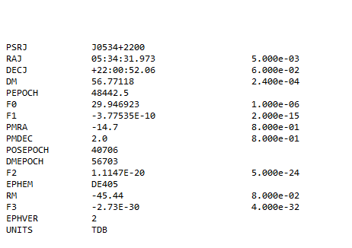
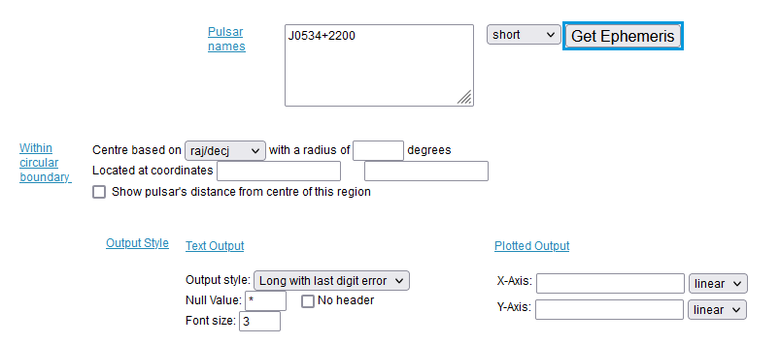
ATNF
Crab Pulsar Example
P0 0.0333924123 1.200e-09
See Appendix A for Parameter definitions. https://www.atnf.csiro.au/research/pulsar/psrcat/psrcat_help.html
For example, F0 is Barycentric rotation frequency (Hz); PO is Pulse Period.
NOTE: For 20m search on the crab pulsar (a pulsar) and not the crab nebula (a SNR)
Crab pulsar is PSR J0534+2200, a.k.a. PSR B0531+22 and also CM Tau
From Catalog DM = 56.77, PO pulse period (s) [Select “long” then Get Ephemeris.
Because frequency is time-dependent, movement toward or away from a radio wave will affect the frequency at which it is detected, i.e., the Doppler effect. One way to control for this movement is to measure barycentric frequency instead of raw frequency. Calculations of barycentric frequency control for the rotation of the Earth and its orbit around the sun.
https://www.atnf.csiro.au/research/pulsar/psrcat/

Slide 24
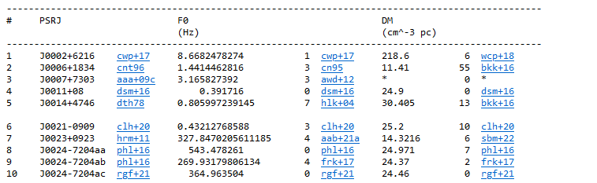

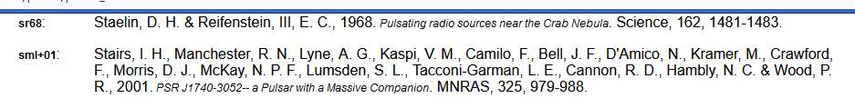

ATNF
ATNF Pulsar Catalogue
Catalogue Version: 1.68
If there is blank in the “Pulsar Name” box, the ephemeris returns a list of all pulsars
…
DM(cm^-3 pc):
56.77118
ljg+15: | Lyne, A. G., Jordan, C. A., Graham-Smith, F., Espinoza, C. M., Stappers, B. W. & Weltevrede, P., 2015. 45 years of rotation of the Crab pulsar. MNRAS, 446, 857-864.

Slide 25
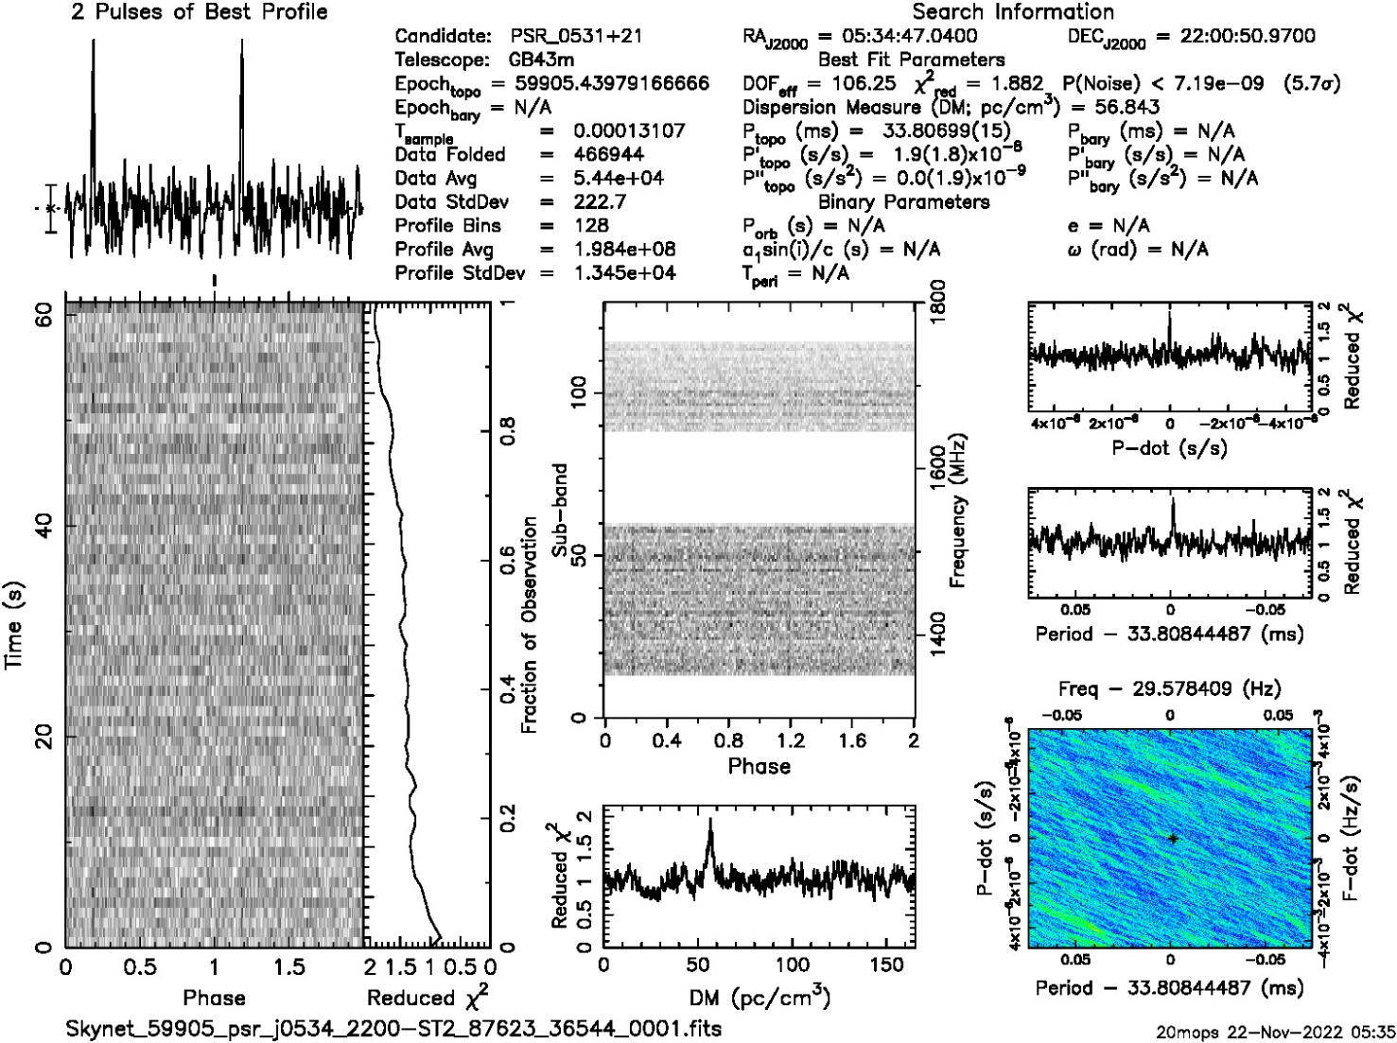
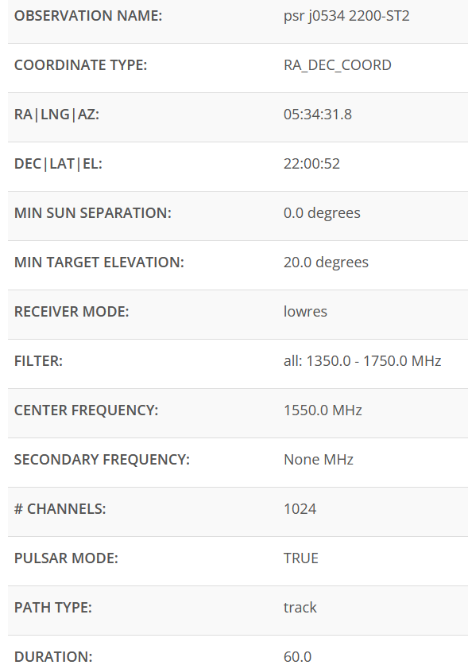
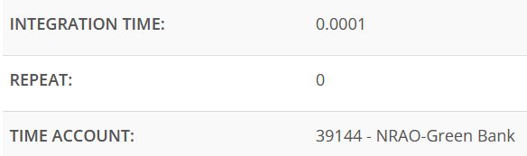
DM Observing – Crab Pulsar
20M Examples

Slide 26
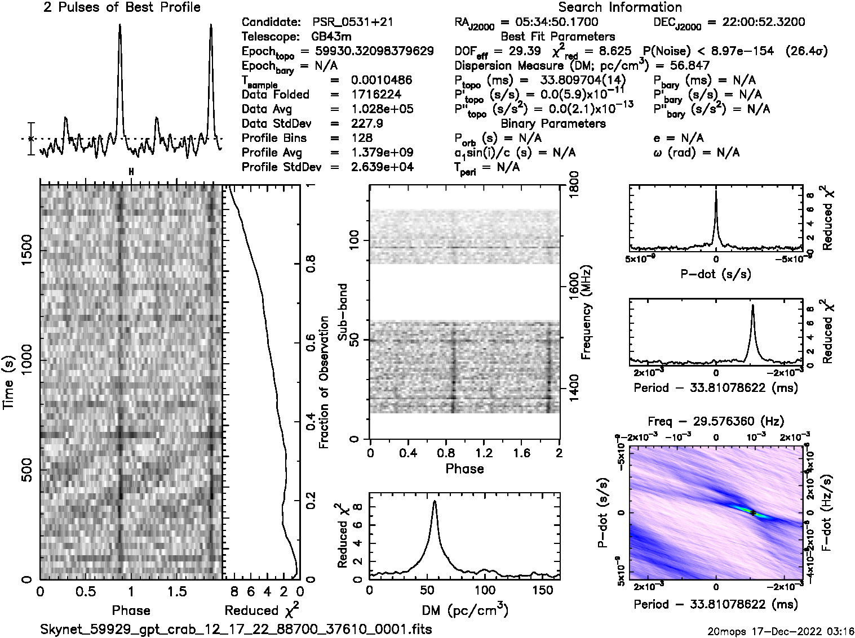
DM Observing – Crab Pulsar
20M Examples
Dispersion Measure Data Displays
Your data will look like this: Here’s a pulsar plot with the different parts labeled. You can find the DM of your pulsar in the Header. There is a dispersion measure or DM associated with data plots. As you analyze data you will need to assess whether this DM falls within accepted values for your candidate using http://pulsarsearchcollaboratory.com/tools/

Slide 27
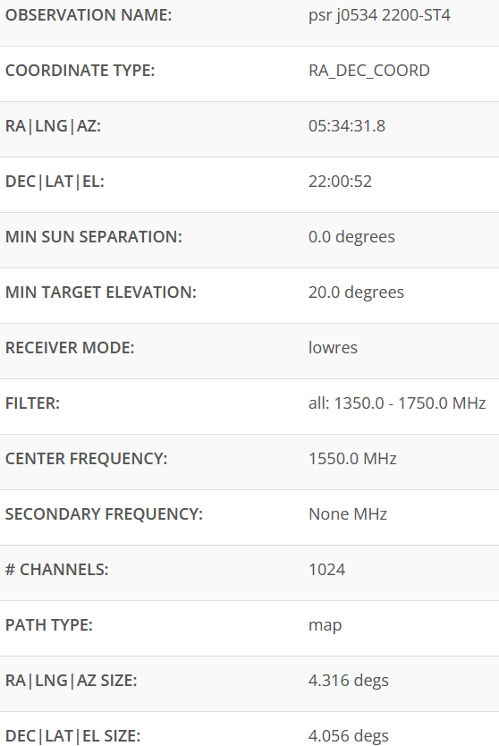
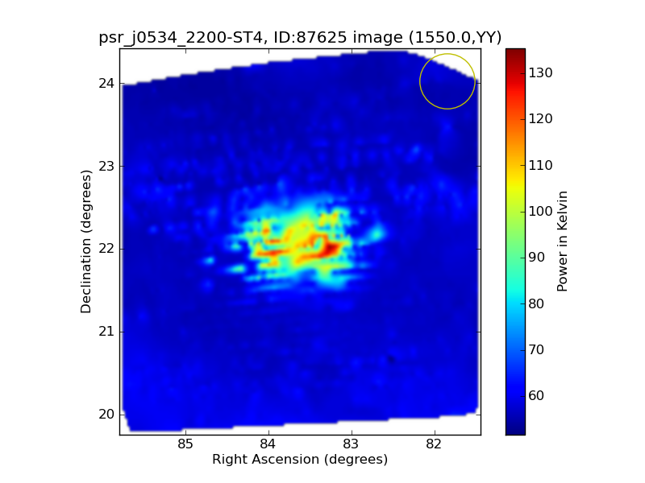
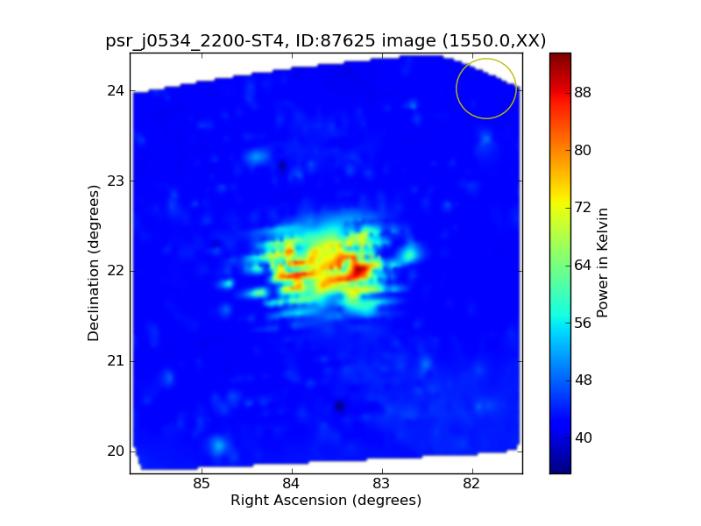
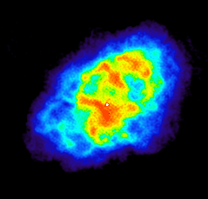
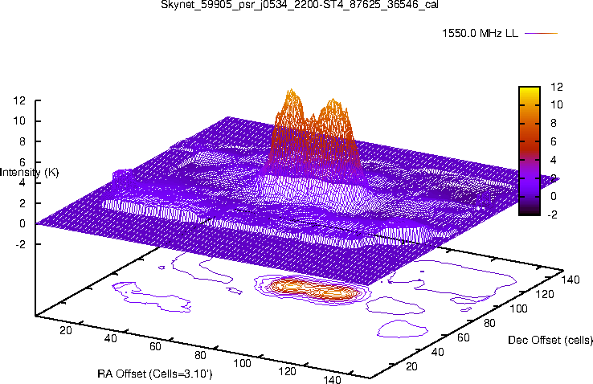
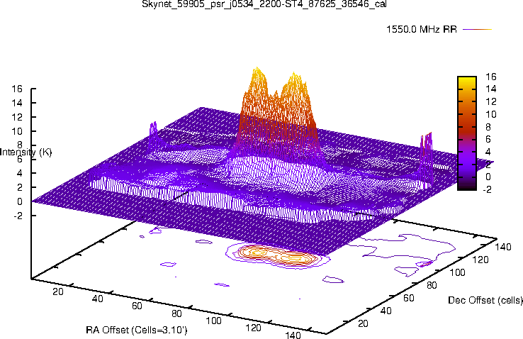
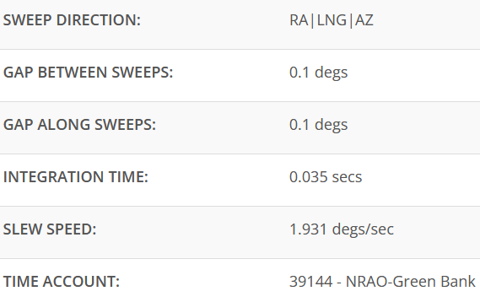
DM Observing – Crab Pulsar
20M Examples
Raster Scans
Crab Nebula in radio Wavelengths
https://imagine.gsfc.nasa.gov/educators/lessons/xray_spectra/crab_radio.html

Slide 28
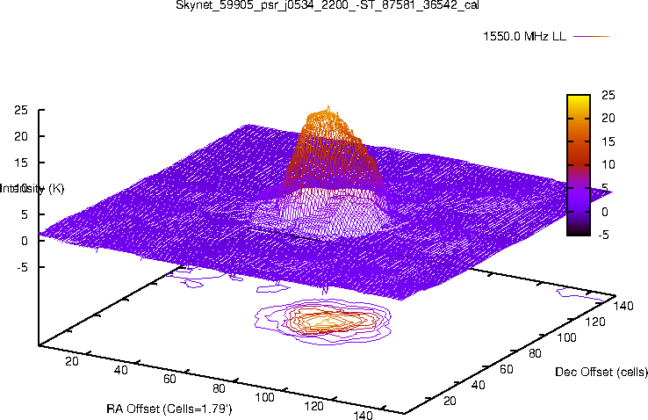
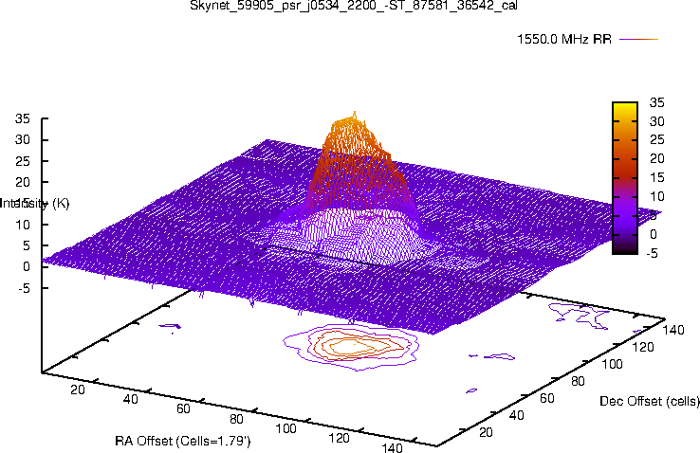
DM Observing – Crab Pulsar
20M Examples
Radio Contour Maps

Slide 29

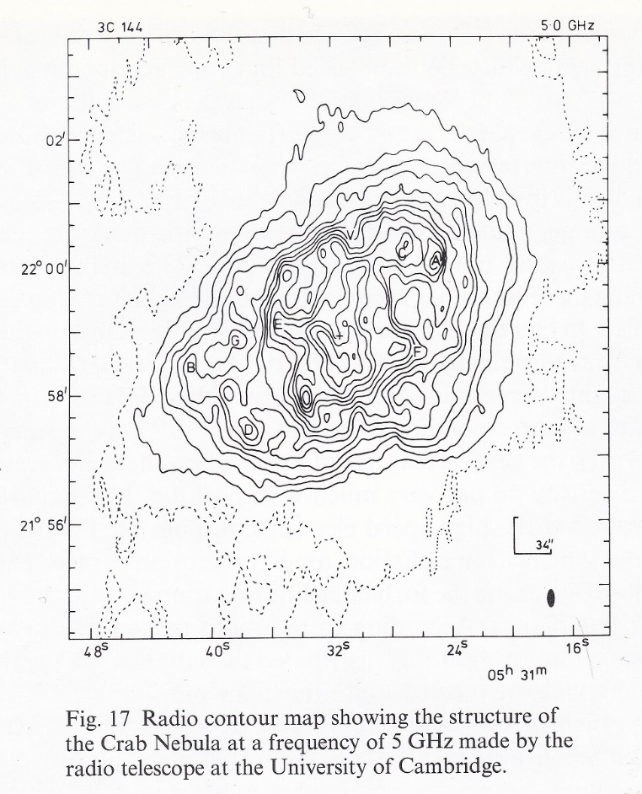
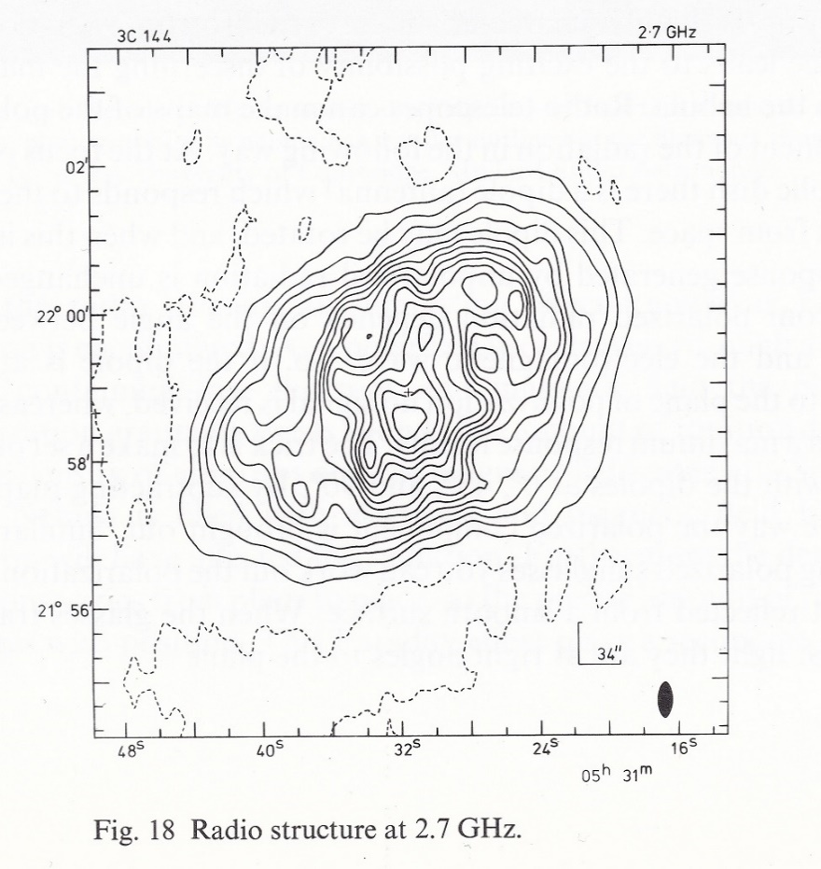
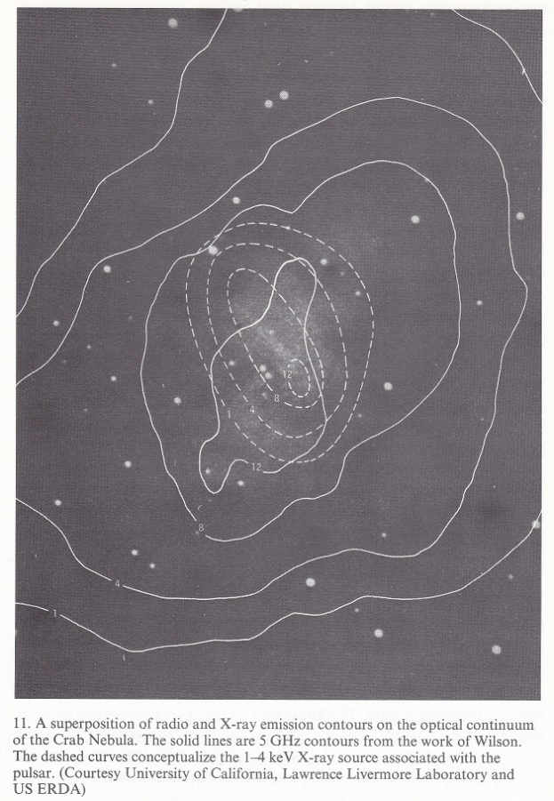
DM Observing – Crab Pulsar
Simon Milton’s The Crab Nebula

Slide 30
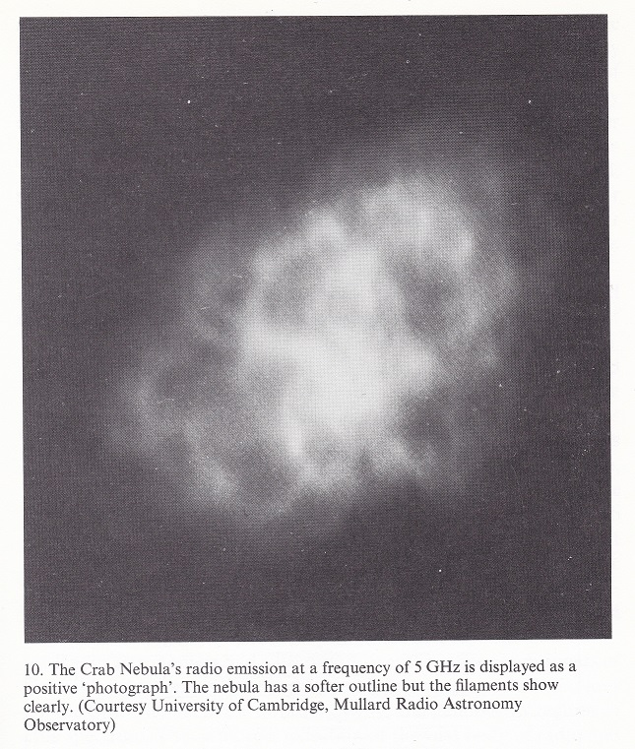
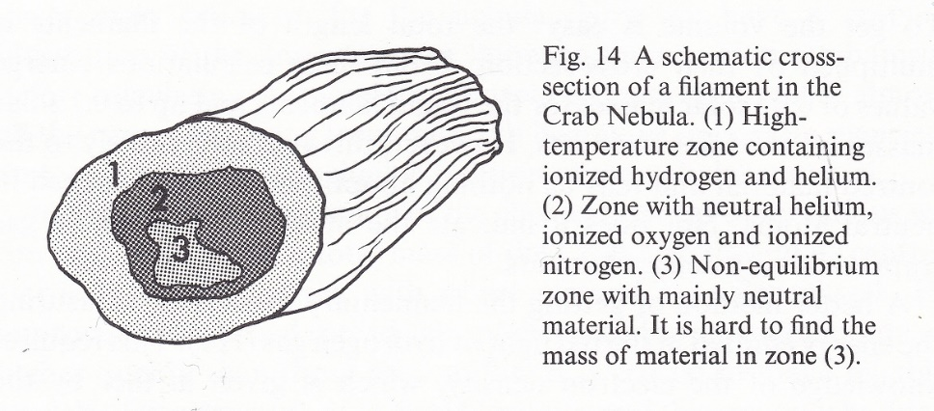
DM Observing – Crab Pulsar
Variations due to discrete structures within the nebula.
Radio pulses from the Crab pulsar are affected
By a variable delay due to changes in dispersion
By a variable pulse broadening due to scattering along the line of sight.
Changes in scattering and dispersion measure are attributable to the effects of an ionized cloud or filament crossing the line of sight. The change in scattering might be due to the cloud itself, or to turbulence induced in a high electron density cloud in the line of sight
Pulse broadening due to multipath scattering depends on the variance and small-scale spatial structure of the electron density. Due to the pulsar’s proper motion, the Earth’s orbit, and the dynamics of the nebula, observed variations in electron number density are larger and the time-scale over which they occur are shorter, compared to typical pulsars. The DM variations and changes in the observed radio pulse shape of the Crab Pulsar are more dramatic than those seen in typical pulsars.
A local electron density comparable to that of the filaments could give rise to the observed changes in the dispersion.
Filament structure: Several phenomena restrict the direction of turbulent flow through the nebula, among which are the magnetic field (along which filaments will tend to align) and the quasi-spherical expansion of the supernova remnant.

Slide 31
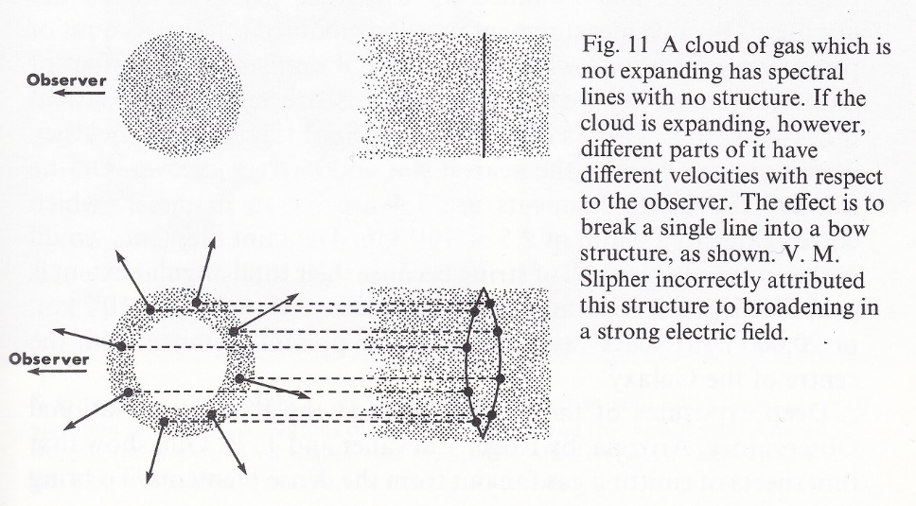
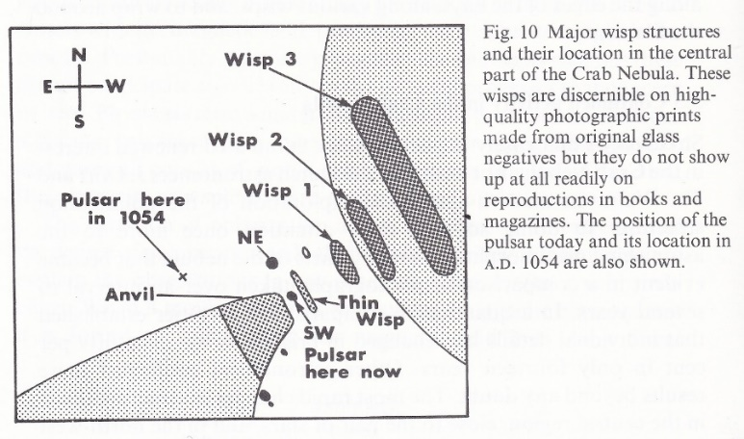
DM Observing – Crab pulsar
Variations due to discrete structures within the nebula.
Pulse Broadening: This is due to multipath scattering depends on the variance and small-scale spatial structure of the electron density.
Wisps: Variations of light ripples, referred to as wisps, were first noticed in the under-luminous inner region of the Crab nebula by Lampland (1921). It was speculated that the Crab pulsar must be responsible for these wisps. Modern observations of wisps started with those of Scargle (1969) who reported, among other findings, violent wisp activities several months after the first reported Crab pulsar glitch (Boynton et al. 1972). Hester et al. (1995) reported the discovery of two brightened quasi-stationary knots. While theoretical models usually identify wisps as the termination shock 1 confining the Crab pulsar wind or structures in a non-relativistic outflow downstream of the termination shock or substructures within the termination shock, it would be very difficult to imagine that the observed bright knots are also results of a termination shock, with one being so close to the Crab pulsar. A different perspective is that wisps and knots are all shock structures in the magnetized relativistic pulsar wind and demonstrate that reverse fast MHD shocks at various spin latitudes can appear quasi-stationary in space when their propagation speeds relative to the pulsar wind are comparable to the relativistic outflow speed.
Ref: Simon Milton’s The Crab Nebula
Ref: Mon. Not. R. Astron. Soc. 294, 443–447 (1998)
Wisps and knots in the central Crab nebula, Yu-Qing Lou
Astronomy and Astrophysics Center, The University of Chicago, Chicago, Illinois 60637, USA

Slide 32
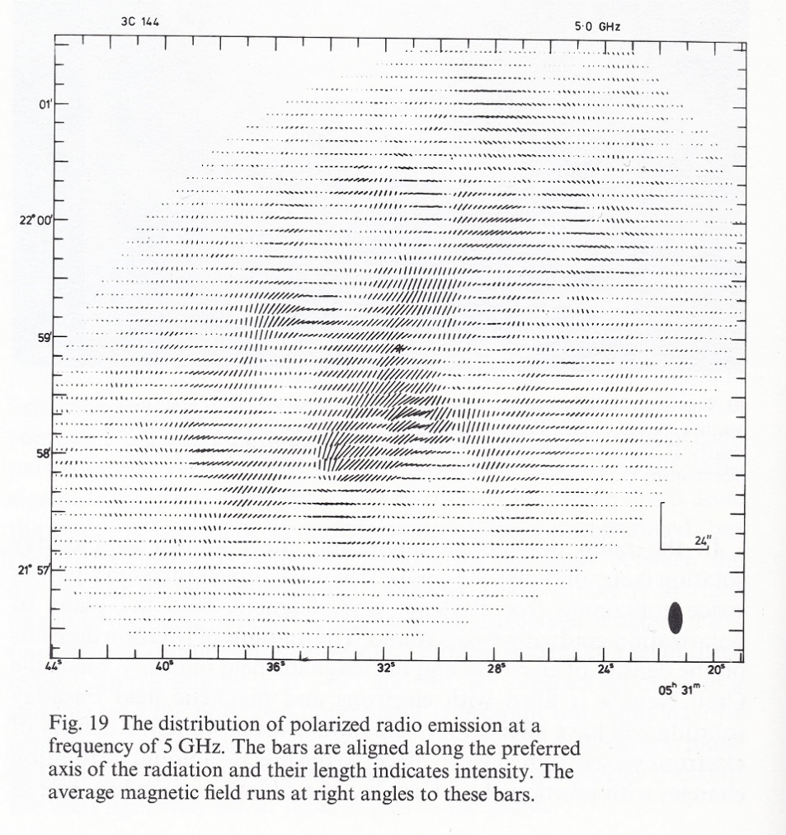
DM Observing – Crab Pulsar
Simon Milton’s The Crab Nebula
Strömgren sphere: is a spherical region surrounding an OB star with the conditions to host an HII region (ionized hydrogen). The term is used for the theoretical spherical volume with a particular calculated radius, and is also used for an observed case adhering to the model. The radius (Stömgren radius) is the maximum distance at which ultraviolet from the star will keep hydrogen ionized. The calculation is based upon a balance between the photoionization and the random recombination of ion and electron. The ultraviolet flux from the Crab Nebula has created a Strömgren sphere of radius ~ 80 pc which has not had time to reach equilibrium. As the size of the ionization front increases, the dispersion measure should increase slowly without affecting the scattering. However, the effect has a very long-time scale and is competing with the dilution of electrons in the nebula due to the latter’s expansion.

Slide 33
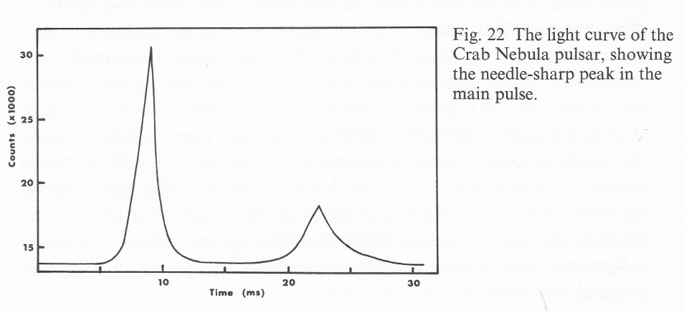
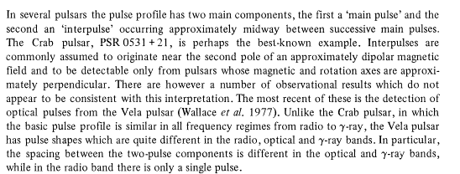
DM Observing – Crab Pulsar
Simon Milton’s The Crab Nebula
Interpulses: Some pulsars exhibit secondary pulses known as interpulses, which follow the relatively stronger main pulses by about half of the pulsar period.
Ref: Pulsar interpulses and other off-pulse emission
E. B. CADY & R. T. RITCHINGS
Nature volume 269, pages 126–127 (1977)
Ref: Pulsar interpulses – two poles or one?
R. N. Manchester, A. G. Lyne
Monthly Notices of the Royal Astronomical Society, Volume 181, Issue 4, December 1977, Pages 761–767, https://doi.org/10.1093/mnras/181.4.761
Published: 01 December 1977

Slide 34
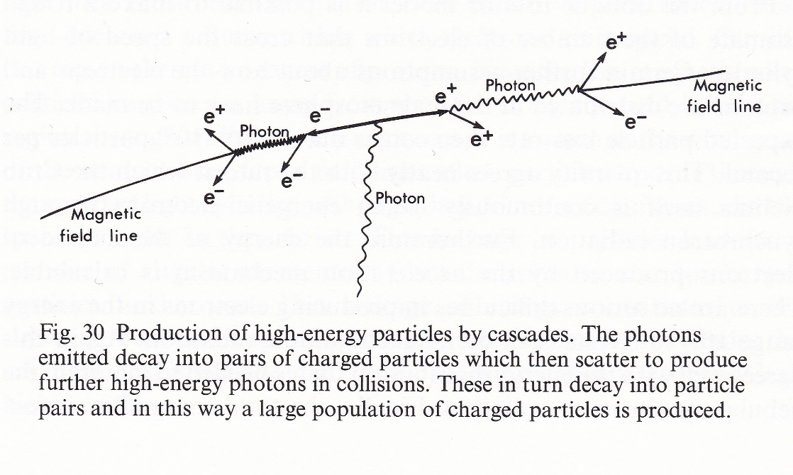
DM Observing – Crab Pulsar
Simon Milton’s The Crab Nebula
Curvature Radiation: Near the magnetic poles the outflowing charged particles are rapidly accelerated to relativistic energies. Then an important process takes place which greatly increases the density of charged particles. The relativistic charges electrons are constrained to move along the curved magnetic field lines. They emit a type of radiation called curvature radiation (in gamma-ray frequency). This high energy and the strong magnetic consequence produces electron-positron pairs. The strong magnetic field separates them before they can reunite to make a photon. Ultimately the energy to make the particles must come from the slow-down of the pulsar. Curvature radiation is considered a possible cause of pulsar radio and/or gamma-ray emissions, particularly the beamed radiation resulting in the apparent pulses.

Slide 35
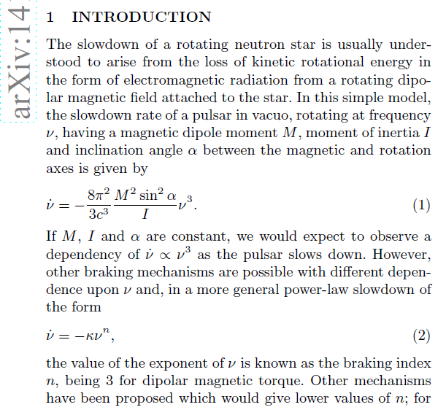
DM Observing – Crab Pulsar
From 1968 - 2015, the rotation rate has decreased by about 0.5Hz, interrupted only by sporadic and small spin up events (glitches). Overall, a low mean braking index of 2.342 is measured for the whole period. The value is interpreted in terms of a braking torque due to a dipolar magnetic field in which the inclination angle between the dipole and rotation axes is increasing. There may also be further effects due to a monopolar particle wind or infalling supernova debris.
Slow-down of the pulsar: The Crab Pulsar is one of very few pulsars to be identified optically. The optical pulsar is roughly 20 km in diameter and has a rotational period of about 33 milliseconds, that is, the pulsar "beams" perform about 30 revolutions per second. The outflowing relativistic wind from the neutron star generates synchrotron emission, which produces the bulk of the emission from the nebula, seen from radio waves through to gamma rays. The most dynamic feature in the inner part of the nebula is the point where the pulsar's equatorial wind slams into the surrounding nebula, forming a termination shock. The shape and position of this feature shifts rapidly, with the equatorial wind appearing as a series of wisp-like features that steepen, brighten, then fade as they move away from the pulsar into the main body of the nebula. The period of the pulsar's rotation is increasing by 38 nanoseconds per day due to the large amounts of energy carried away in the pulsar wind.
.
The slowdown of a rotating neutron star is usually understood to arise from the loss of kinetic rotational energy in the form of electromagnetic radiation from a rotating dipolar magnetic field attached to the star. In this simple model, the slowdown rate of a pulsar in vacuo, rotating at frequency ν, having a magnetic dipole moment M, moment of inertia I and inclination angle α between the magnetic and rotation axes is given by
If M, I and α are constant, we would expect to observe a dependence of
ν˙∝ν3 as the pulsar slows down. However, other braking mechanisms are possible with different dependence upon ν and, in a more general power-law slowdown of the form
the value of the exponent of ν is known as the braking index n, being 3 for dipolar magnetic torque
The so-called braking index (n), which is a quantity closely related to the pulsar spin down, can provide information as regards the pulsars’ energy loss mechanisms. Such mechanisms can include Gravitational Wave (GW) emission, among others.
Ref: 45 Years of Rotation of the Crab Pulsar
Andrew Lyne, et al.
arXiv:1410.0886 [astro-ph.HE]
[Submitted on 3 Oct 2014]

Slide 36
DM Observing
Why all the DM Theory?
Maybe it can be applied toward a proposed SARA VLA / VLBA pulsar project.

Slide 37
DM Observing - Other
Radio Transients:
They exhibit drastic variations in brightness over time scales from milliseconds to years. These include events such as Fast Radio Bursts (FRBs), X-ray binary systems (XRBs), soft gamma repeaters (SGRs), gamma ray bursts (GRBs), supernovae and Rotating radio transients (RRATs). Most of these transients are associated with ejections of matter, in some cases at ultra relativistic speeds that can produce radiation at radio frequencies.
RRATs are sources of short, moderately bright, radio pulses, discovered in 2006. RRATs are thought to be pulsars, i.e., rotating magnetized neutron stars which emit more sporadically and/or with higher pulse-to-pulse variability than the bulk of the known pulsars. Over 100 have been reported.
Ref: Sampling the Radio Transient Universe: Studies of Pulsars and the Search for Extraterrestrial Intelligence, Chennamangalam, Jayanth, 2014
Extragalactic fast radio bursts (FRBs):
Have large dispersion measures (DMs) and are unique probes of intergalactic electron density fluctuations.
Ref: Dispersion measure distributions of fast radio bursts due to the intergalactic medium (IGM), Medlock & Cen, 2021
Ref: Estimates of Fast Radio Burst Dispersion Measures from Cosmological Simulations, Pol, et al, 2019
Gravitational Wave Observation:
Pulsar radio emission undergoes dispersion due to the presence of free electrons in the interstellar medium (ISM). Correcting for this delay accurately is crucial for the detection of nanohertz gravitational waves using Pulsar Timing Arrays.
Ref: High Precision Measurements of Interstellar Dispersion Measure with the upgraded GMRT, M. A. Krishnakumar, et al., 2021, arXiv:2101.05334 [astro-ph.HE]
Speculation for a New Tired Light (NTL) Theory:
Is an alternative cosmological theory to the Big Bang. In NTL the universe is static and redshifts are caused by photons of light interacting with the electrons in the plasma of the intergalactic medium (IGM).
Ref: Improvement of Cosmological Constraints with the cross-correlation between line-of-sight optical galaxy and the FRB dispersion measures, Zhu et al, 2022
Ref: A Relationship between Dispersion Measure and Redshift Derived in Terms of New Tired Light Article in Journal of High Energy Physics Gravitation and Cosmology · August 2016 Lyndon Ashmore

Slide 38
Contact
Email SARA Section Analytical Section Coordinator
Tzikas@alum.rpi.edu
stephentzikas@gmail.com

